Slide 1
Getting Started with AWS Cloud

Slide 2
Cloud Computing ?
Benefits of CC:
Pay as you go i.e, pay only for how much you use.
Lower in cost than on-premises.
Increased speed & agility, flexible storage capacity.
We can easily deploy applications in multiple region within a minute.
CC is the on-demand delivery of IT resources over the internet.

Slide 3
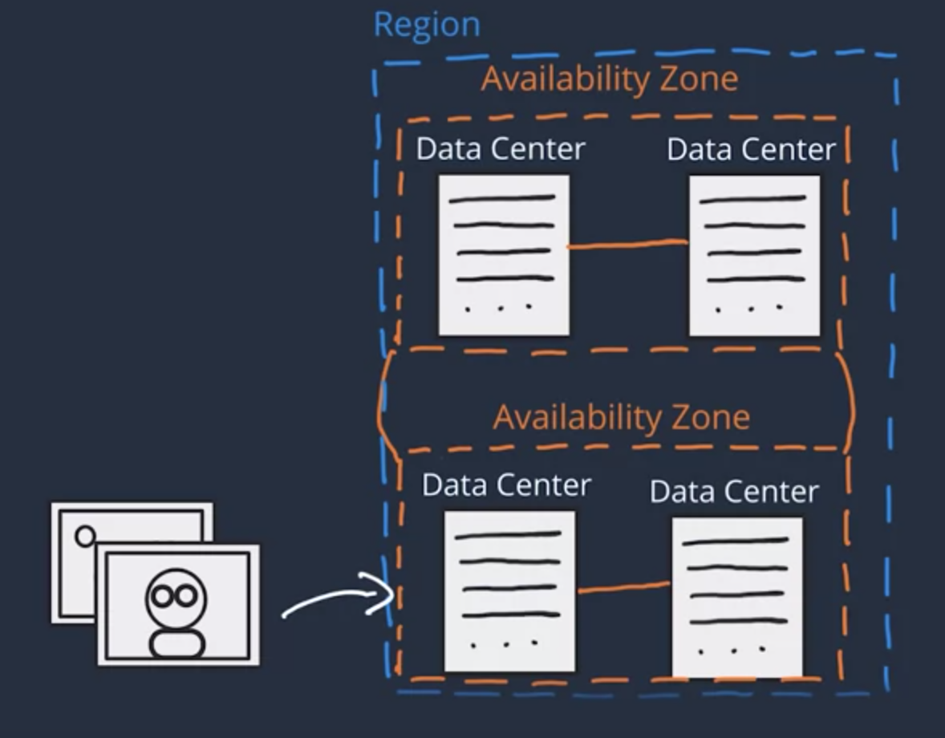
AWS Global Infrastructure
In AWS, the physical infrastructure makes up the AWS global infra, in the form of AZs and regions. AZ = Availability Zones

Slide 4
Interacting with AWS
Methods to make API call in AWS:
AWS management console.
AWS command line interface.
AWS software development kits.
Every action in AWS is an API call that is authenticated & authorized.

Slide 5
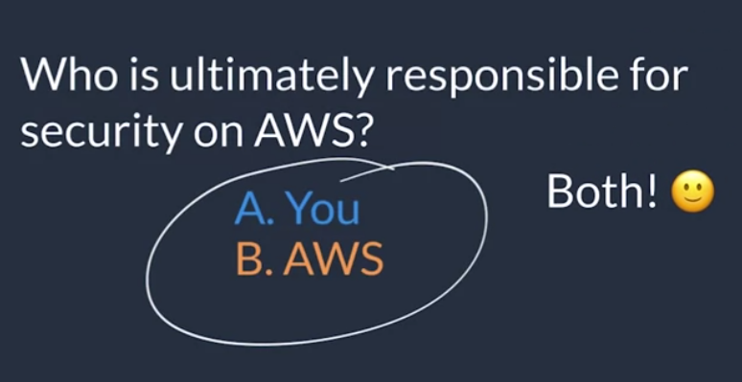
Security & AWS Shared Responsibility
AWS for security of the cloud.
Customer for security in the cloud.

Slide 6
Shared responsibility model
AWS is responsible for: A. Protect & secure infrastructure that runs all the service. B. Protecting regions, AZs, data centers. C. Manage hardware, software, and networking components that run the AWS services, etc.
Customer is responsible for: A. Controlling the OS and application platform. B. Managing customer data, encrypting the data, protecting through network firewall. C, Proper configuration of services and applications.
AWS
Customer

Slide 7
Root user in AWS?
Authentication and authorization in AWS:
Authentication means “are you who you say you are?”
Authorization means “what actions can you perform?”
AWS root user credentials:
Email address and password, it allows to access AWS management console.
Access keys, it allows to make programmatic requests from AWS CLI or AWS API.
When we first create an AWS account then one identity has full access to all of the AWS services, that is root user.

Slide 8
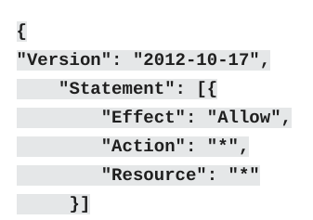
Identity & Access Management in AWS
IAM user:
It represents a person or service that interacts with AWS.
All the task an IAM user perform is controlled by root user.
Collection of IAM user is called IAM group.
To manage access & permissions to AWS services & resources we create IAM policy.
IAM is a web service that allows us to manage access to AWS account & resources.
Stored in AWS as JSON documents

Slide 9
FAQs

Slide 10
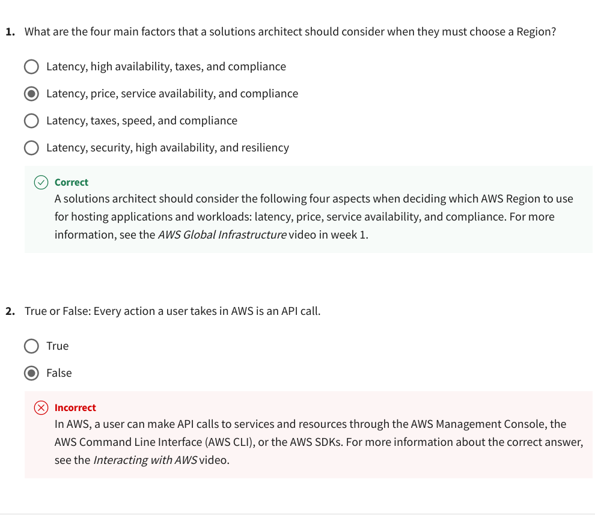

Slide 11
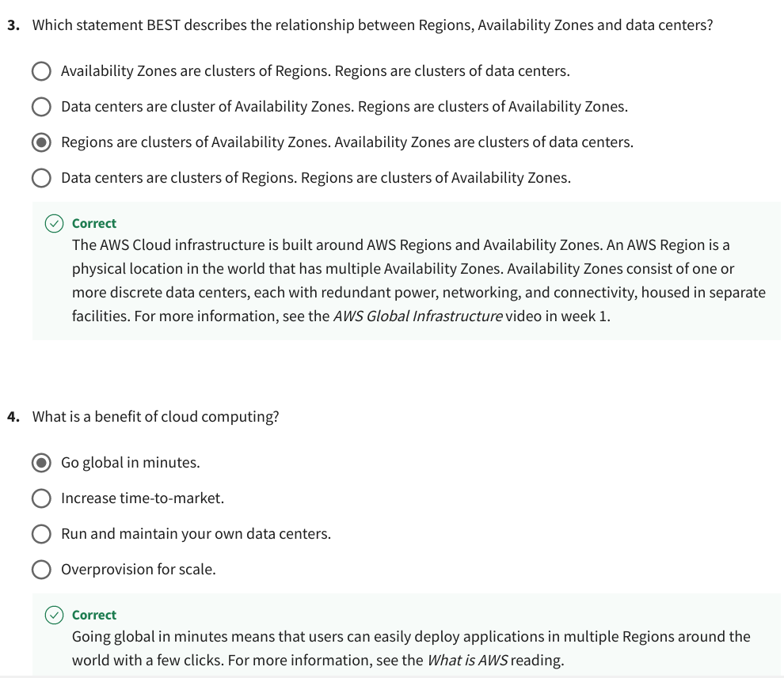

Slide 12
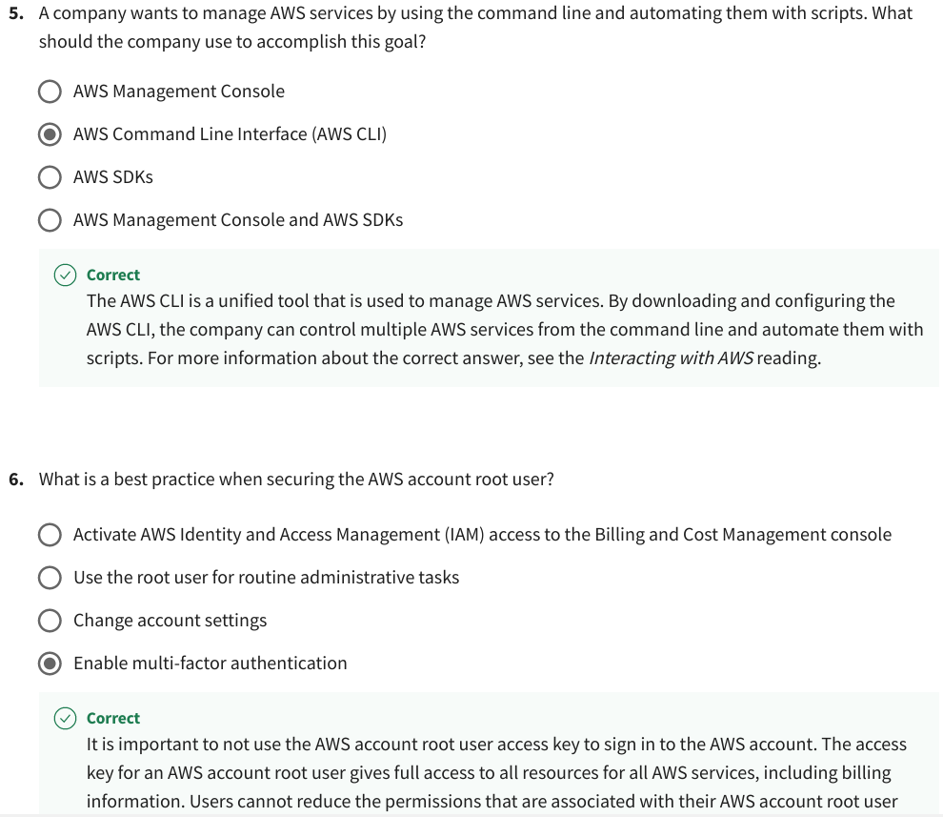

Slide 13
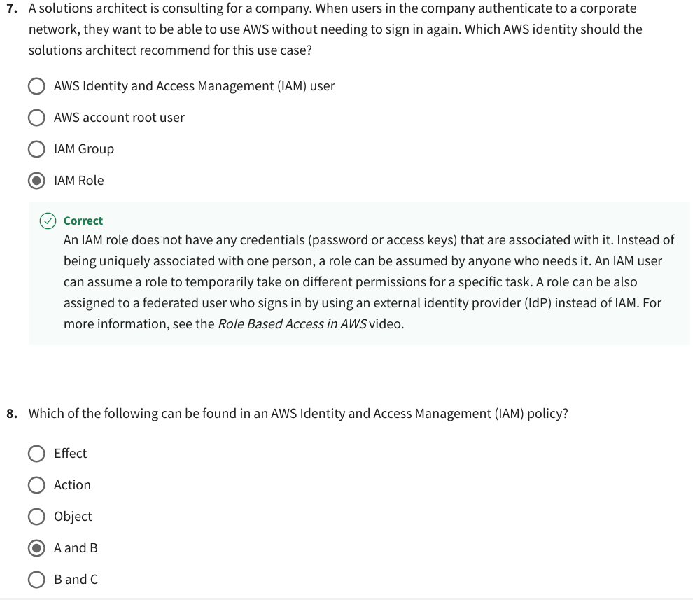

Slide 14
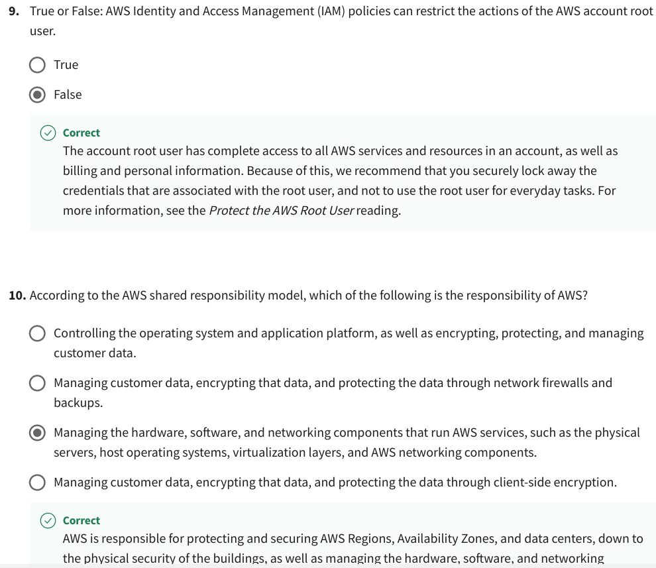

Slide 15
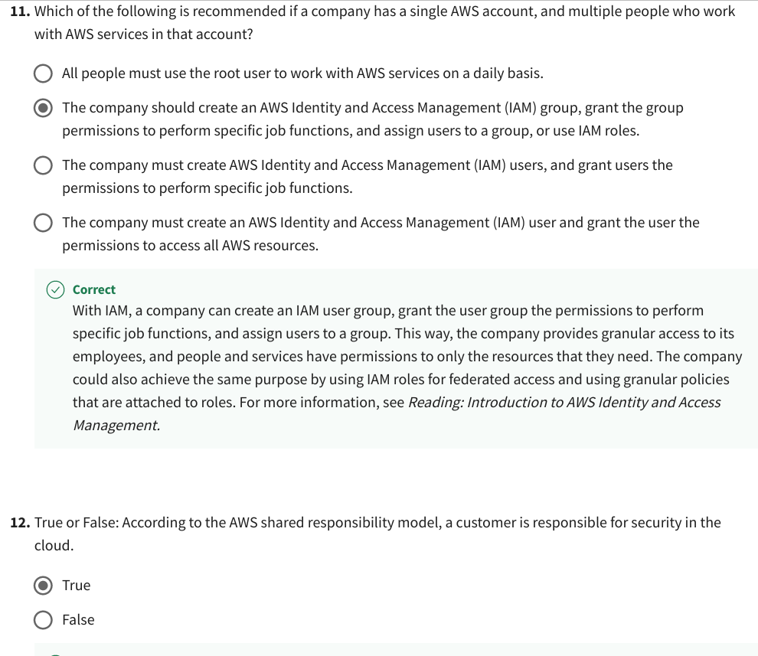

Slide 16
